Slide 1
Seating Excellence since 1928
This presentation is confidential and is intended only for the individual named. Disclosing, copying, distributing or taking any action in reliance on the contents of this information is strictly prohibited

Slide 2
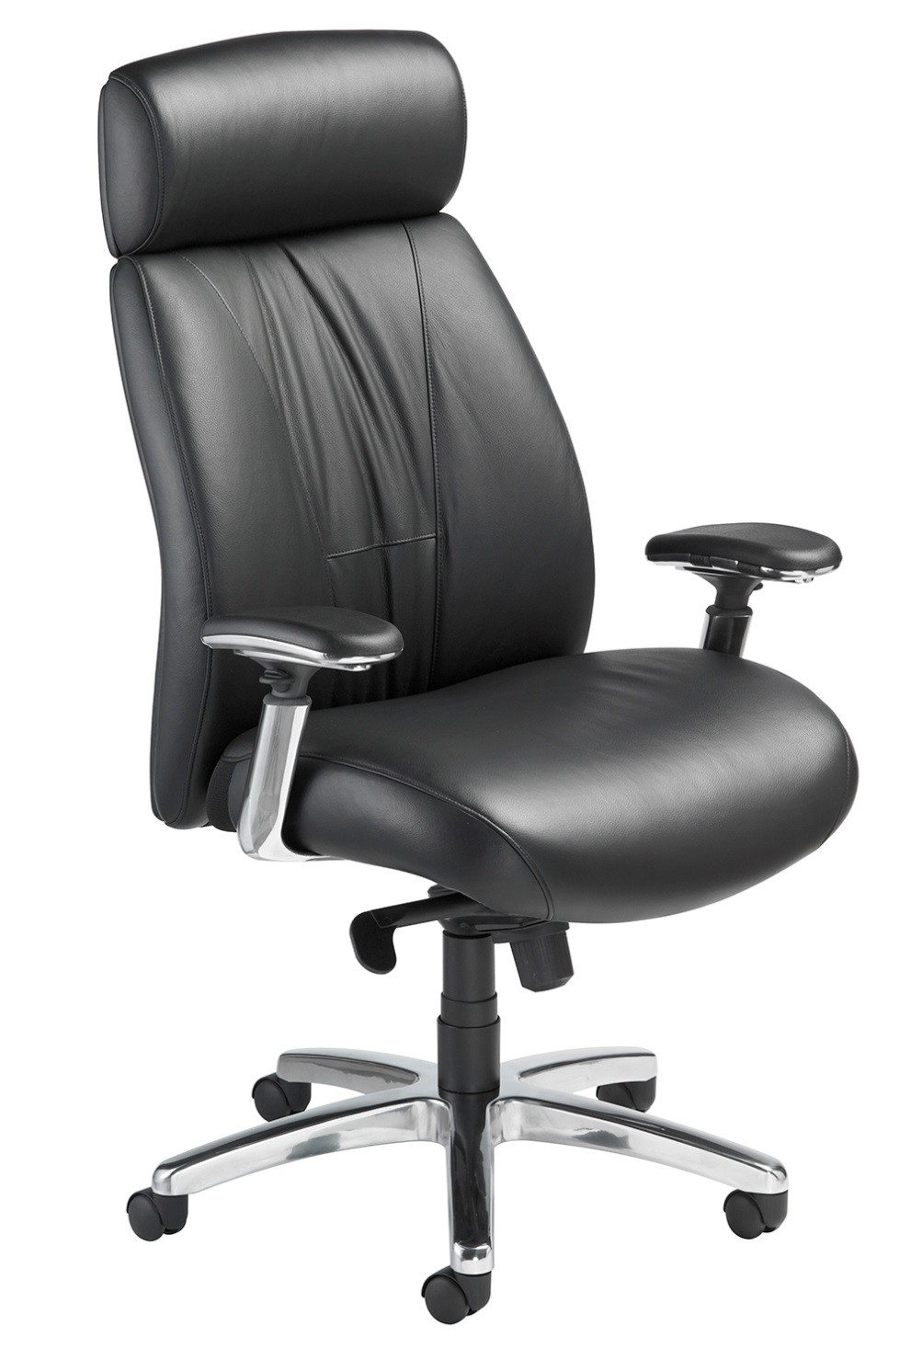
Govern in Comfort
Energy absorbing ENERSORB™ seat and back cushioning support your
Executive Decisions
Your Best Decision

Slide 3
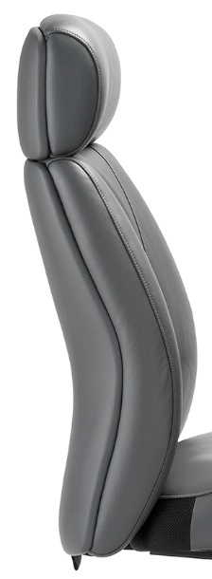
Back
Compound curved back
Built-in lumbar support
2” ENERSORB™ thickness
Headrest
2” ENERSORB™ thickness

Slide 4
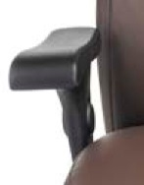
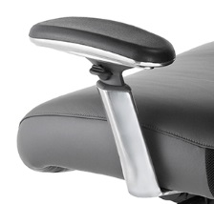
Arm
Standard with height adjustable arms with polyurethane arm pad
3D Arm
Pivoting arm pads with a 30° range of motion inward and outward, height and depth adjustment

Slide 5
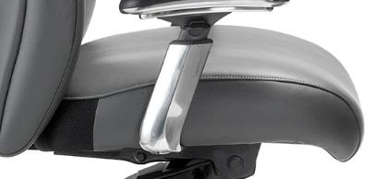
Seat
Breathable mesh at back of seat allows for air release related to leather cover
Waterfall front
3” ENERSORB™ thickness

Slide 6
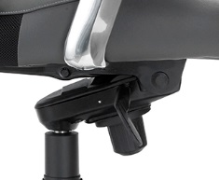
Mech
Synchronous knee-tilt mechanism with 2:1 ratio allows user to remain in correct alignment when reclining
Tension control

Slide 7
Controls
Right side:
Pneumatic height adjustment
Left side:
Multi position tilt lock

Slide 8
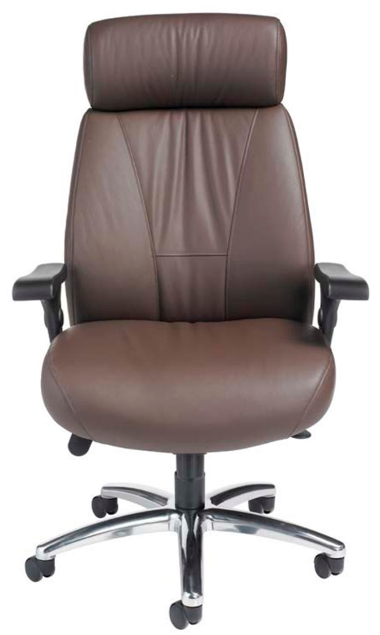
Leather Plus
Standard / Madras
Princess
Always Italian
Vinyl or Full Leather Upholstery
* NOTE: A pillow upholstery technique is used with vinyl, leather
or leather plus to provide a wrinkled, plush appearance

Slide 9
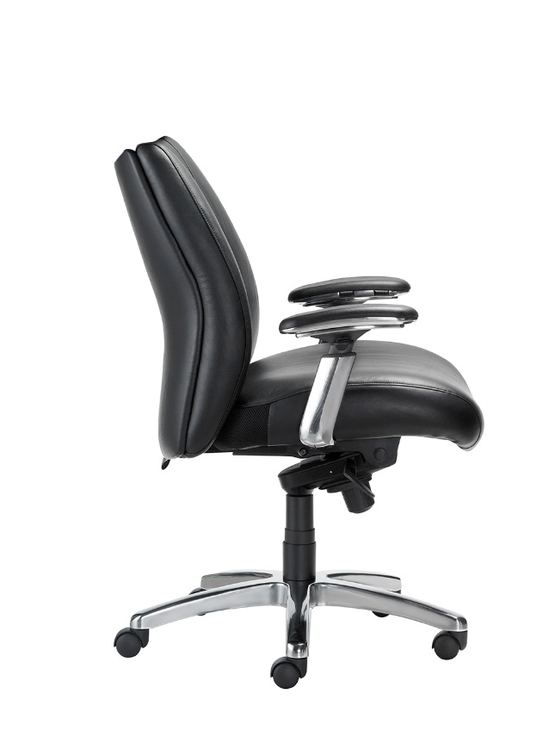
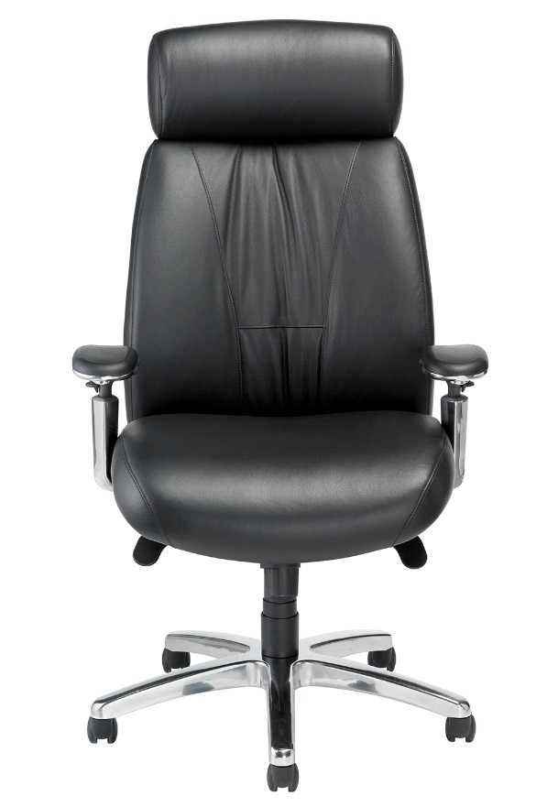
OPTIONS
Soft Tile Casters 2”
3" Carpet Casters
Adjustable Lumbar Support
Polished Aluminum
Base and Arms
California Fire Code #133
Mid- Back or High-Back

Slide 10
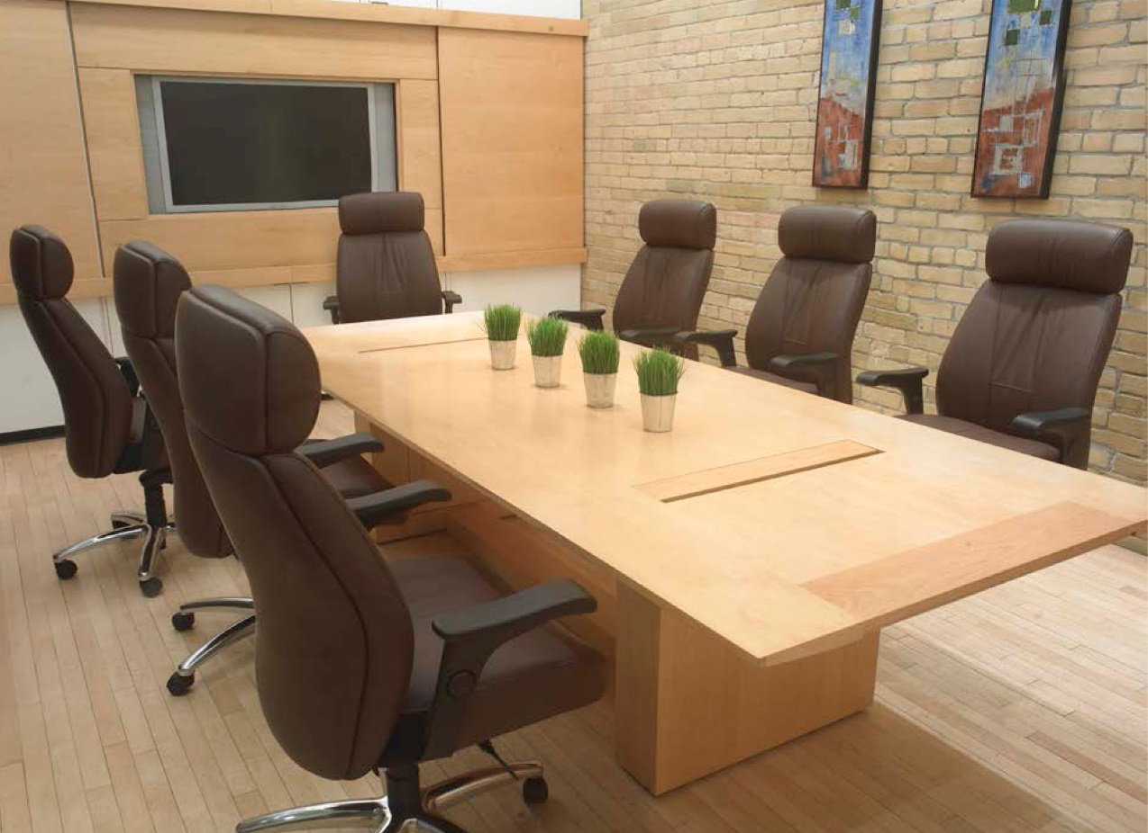
Applications
Executive:
Lawyers & Accountants
Workers
Compensation claim
Gaming
Boardroom

Slide 11
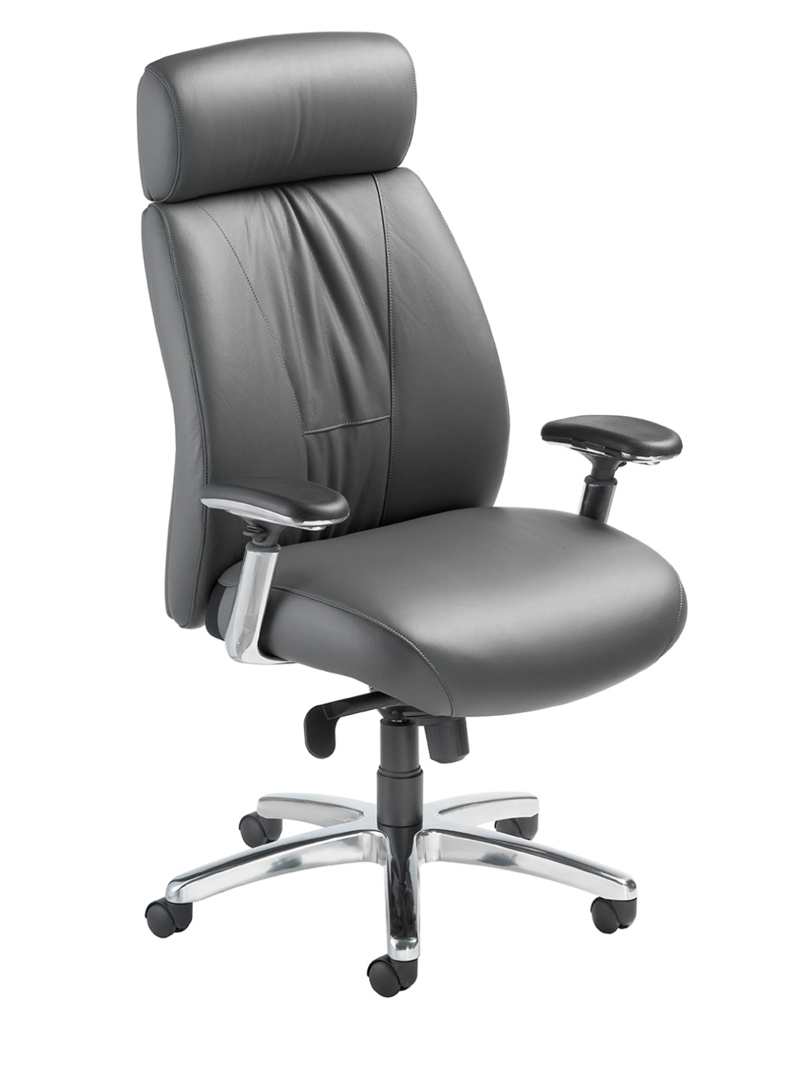
Level 1 e3 Certified
GREENGUARD Children & School and Indoor Air Quality Certified
Nightingale is a 100% waste free facility; powered by Solar & Wind

Slide 12
Rating & Warranty
Rated for users up to 300 pounds, for a 40 hour work week
Lifetime Limited: All non-moving metal parts.
10 Years: Frame & Parts
5 Years: Upholsteries

Slide 13
Any Questions ?

Slide 14
Mark Francis
Learning & Development Manager
Nightingale University
905.896.3434
800.363.8954
Ext 204
mfrancis@nightingalechairs.com
www.nightingalechairs.com

