Slide 1
Leather Grade Distinctions
Seating Excellence since 1928
This presentation is confidential and is intended only for the individual named. Disclosing, copying, distributing or taking any action in reliance on the contents of this information is strictly prohibited

Slide 2
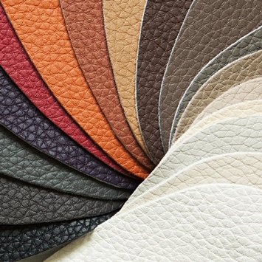
Look no Further for the Leather Look
Standard / Madras
Princess

Slide 3
Factors Affecting Raw Leather Quality
Lower Alps: Italy, Other Areas: US, South America
Switzerland & South Germany Russia, Australia, South Africa & Asia
Stable climate year round Extreme temps
Stone and wood fences Barbed wire fences
Ear tags Branding
Grass fed Grain fed
No growth hormones Growth hormones
No electric prods Electric prods
Free range Feeder pens
Minimal insect bites Insect bites / parasites common
90% Hide Yield 60% Hide Yield
* Hide Yield is percentage of whole hide suitable for use

Slide 4
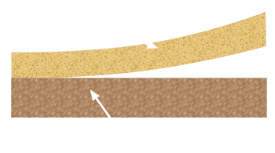
Split Hides
Bottom - Split Leather; used for 'cowhide work gloves', etc
Top - Top Grain Leather; used for high quality footwear, purses, sofas, etc
'Top Grain Leather' is further divided into two basic categories: Full or Semi-Corrected,
based on quality
* ‘Top' indicates the top portion of a hide, not the quality of the leather and is in reference is to where the leather was cut, rather than the grade

Slide 5
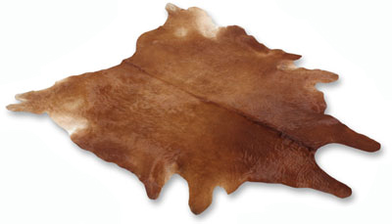
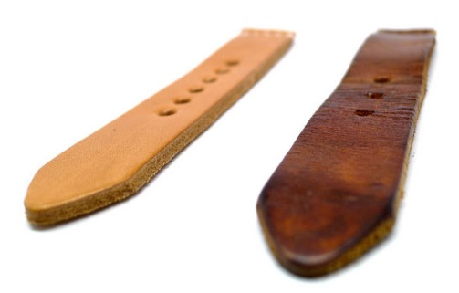
Semi-Corrected : Standard/Madras
Imperfections are corrected or sanded off, and an artificial grain embossed into the surface and dressed with stain or dyes
Full : Princess
Hides that have not been sanded or buffed to remove imperfections, such as scars, insect bites, on the surface of the hide
Advantages:
Strength and durability
Breathability: If leather cannot breathe and absorb moisture it will dry and crack
Rather than wearing out, it develops a ‘patina’ during its expected useful lifetime
Patina

Slide 6
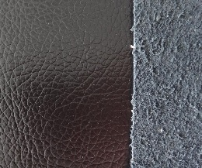
Bonded Leather
Man-made layer of a fiber or paper backer, a pulp made from shredded leather [very similar process to a paper mill] mixed with bonding materials and given a polyurethane coating which is embossed with a
leather-like texture
Disadvantages:
Flaking, or peeling;
sometimes very quickly
No way to know how long it
will last due to proprietary mfg process of various mfg

Slide 7
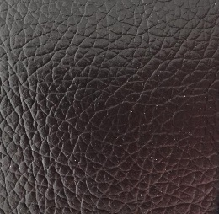
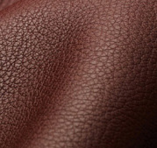
Genuine leather is made from full hides and cost much more than
bonded leather
Hard to tell the difference between the two, as once an item is made with bonded leather the appearance and smell
are nearly identical

Slide 8
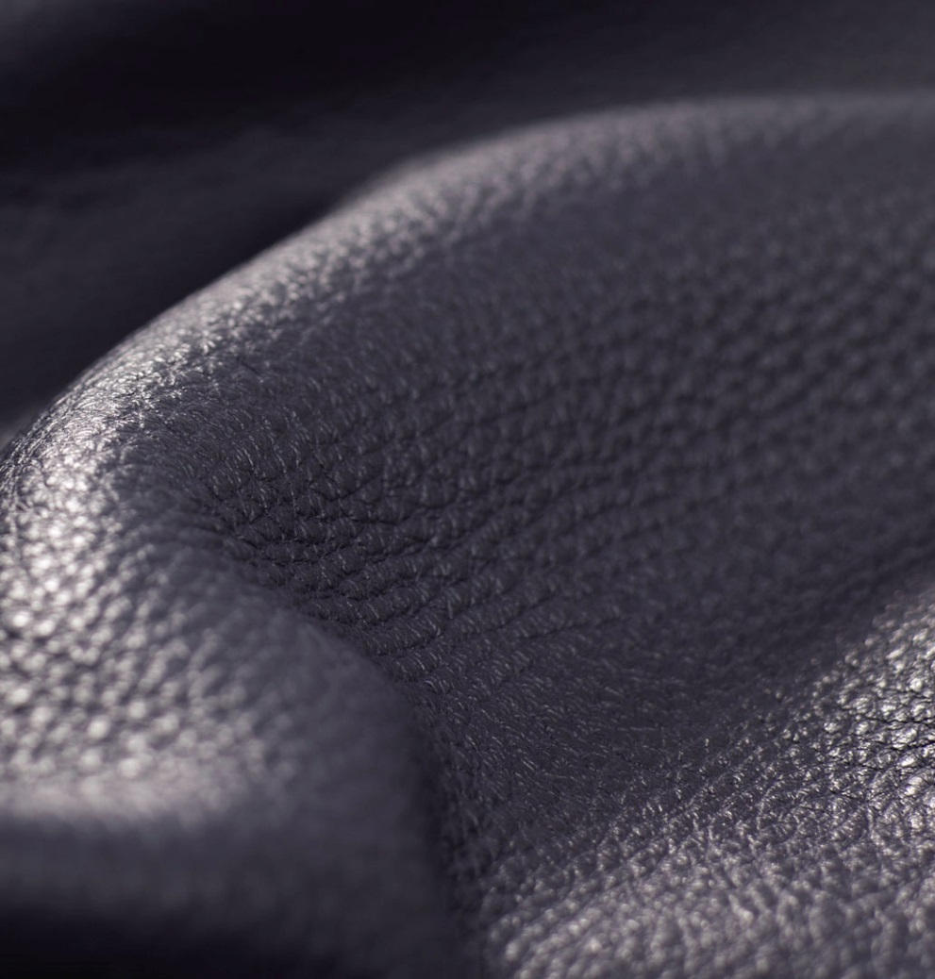
Full Analine Leather
Dyed exclusively with soluble dyes [synthetic, organic and carbon-based compounds] without any surface coatings; retaining the hide’s natural surface with the complete original animal's skin structure; scars, pores, etc
All analine leathers are first fully immersed in an aniline dye solution. Through this process the aniline dye completely diffuses into the leather, highlighting the natural
beauty of the hide

Slide 9
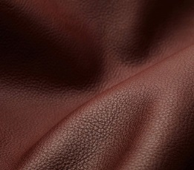
Aniline dyed leather will vary in color not only within the hide, but also from hide to hide
Dye lots differ
Advantages:
Color doesn’t rub off
Superbly soft and supple; because no other coating or pigment is used
‘Better with Age’

Slide 10
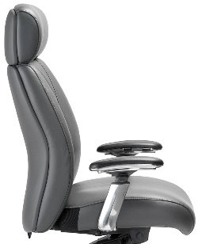
Leather Plus
Front of back, headrest
and seat covered with Standard/Madras leather
Back of back & headrest covered with matching vinyl
Grade 4
Princess: Chair back front, back and seat all fully covered with
Princess Leather
Leather
Matching Vinyl

Slide 11
ENERSORB™ Movement
To allow for the dynamic movement of ENERSORB™ we incorporate a layer of Dacron™ between the leather and ENERSORB™
Additionally, there is a section of the back of the seat that is made with Mystic stretch fabric which
allows for breathability
Mystic
stretch fabric

Slide 12
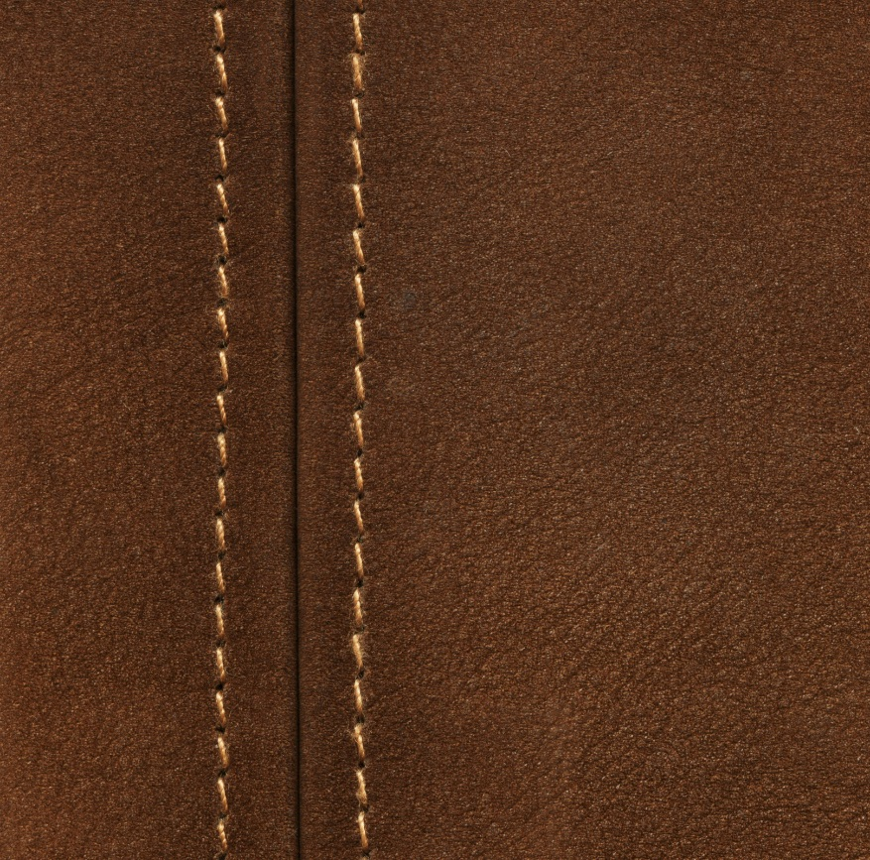
Double Stitching
Fabric [India Strip] is placed underneath the seam, and double stitched, where the leather pieces join
This strengthens and reinforces the seam to avoid stretching or tearing to the seam by the natural stress put on seam by
the users weight

Slide 13
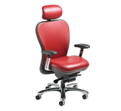
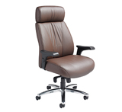
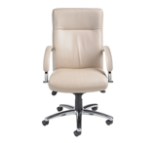
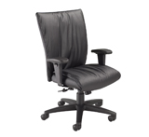
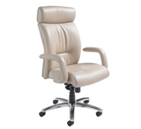
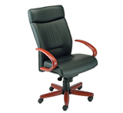
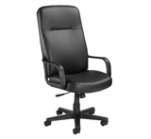
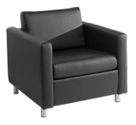
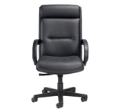
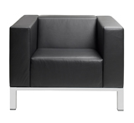
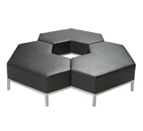
CXO L6200D Presider 7700D Khroma 3400D
Like the Look
of Leather ?
Look no Further
Executive
Boardroom
Guest Waiting
Staff Lounge
Statement : front desk
Escape 7100D Manno 8600D Manno Timber 8660D
Proxy 4900D Danforth Reward_4800
Lakeshore 1301 Lakeshore Interlock

Slide 14
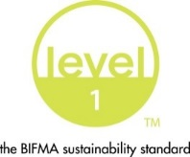
Level 1 e3 Certified
GREENGUARD Children & School and Indoor Air Quality Certified
Nightingale is a 100% waste free facility; powered by Solar & Wind

Slide 15
Rating & Warranty
5 Years
Standard : 250 – 300 pounds
40 hour week
3 Years
Heavy Duty : 350 – 450 pounds
27/7 usage

Slide 16
Questions

Slide 17
Mark Francis
Learning & Development Manager
Nightingale University
905.896.3434
800.363.8954
Ext 204
mfrancis@nightingalechairs.com
www.nightingalechairs.com

