Slide 1
ENERSORB™
Seating Excellence since 1928
This presentation is confidential and is intended only for the individual named. Disclosing, copying, distributing or taking any action in reliance on the contents of this information is strictly prohibited

Slide 2
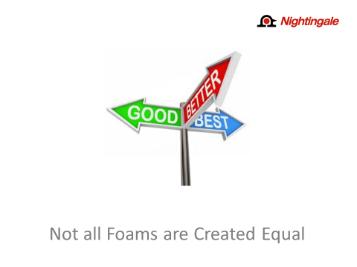
3 types of foams are
used for seat cushioning:
Fabricated – Good
Moulded – Better
ENERSORB™ – Best
Today we are going to see, and experience, the difference !

Slide 3
Moulded and Fabricated are
the most commonly used seat foams in both offshore & domestically made chairs
Both have the same basic structure; very large bubbles,
with very thin walls
Both types of cushioning initially provide a very comfortable sit

Slide 4
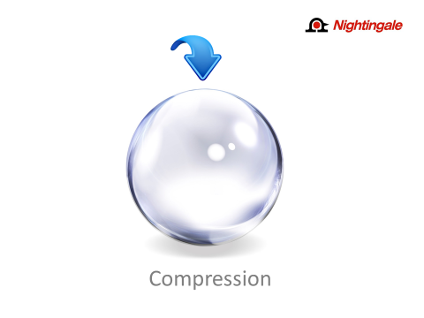
When seated, our weight immediately begins to ‘push down’ on the cushioning
Changes to the shape of these large, thin walled bubbles is permanent over time and can quickly strip the chair of any seat cushioning benefits, critical to the support of the user

Slide 5
This ‘pushing down’, or compressing,
of the bubbles leads to wall breakage,
resulting in the user feeling pressure
spots on the back of their upper legs
as their weight is now sitting on
the seat pan
This is what causes the ‘grooving’ in a seat
The rest of the chair may be in good working order, but when the cushioning is compromised the user will need a new chair

Slide 6
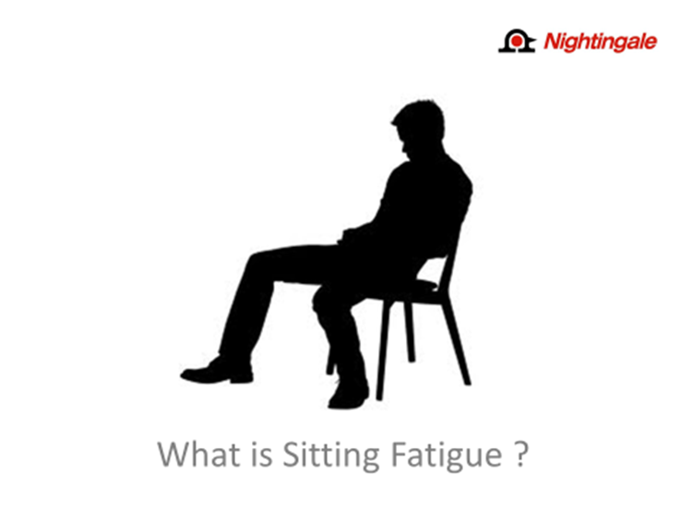
While we sit our muscles are working to maintain our torso,
neck and shoulders in a steady position
A stationary working position squeezes the blood vessels in
the muscles reducing the blood supply to the working muscles just
when they need it the most
This is why someone sitting, in an unsupportive chair, all day at their job can be even more tired than a construction worker at the end of the day

Slide 7
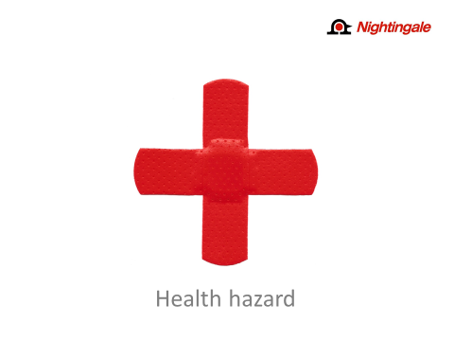
Mobility restrictions, such as damage to the shoulders
rotary cuff
High tension on the spine can impede blood flow to the spinal discs, limit their nutrition and can contribute to their premature degeneration
Pressure spots can lead varicose veins, and further to Thrombosis
or blood clotting, deadly if the clot breaks free and travels to the heart or brain
Initial troubles are minor, ranging from slight back pain, muscle tenderness, stiff necks, and numbness in the legs
Perhaps the most dangerous and neglected aspect of incorrect and unsupported seating is that it can be a gradual deterioration of health over a 30 to 40 year timeframe

Slide 8
Work related musculoskeletal
disorder claims per year: 650,000
Costs to Employers: 20 + Billion $
$1 of every $3 of Worker's
Compensation costs are spent
on occupational musculoskeletal disorders
Indirect costs are 3 to 5 times
higher, reaching approximately
$150 Billion per year
U.S. Bureau of Labor Statistics
Companies spend millions annually for Ergonomic Assessments
Concern is not only for the employee’s well being, but also for the companies financial health

Slide 9
The silicone surfactants also build
strength in the cell wall, which makes
ENERSORB™ more elastic and helps to
redistribute the applied pressure over
a wider area
These silicone coatings are contrasted
with petroleum coatings used on other
foams that tend to cause ‘stickiness’
and lack of response
ENERSORB™ Other
Slippery Sticky
Dry Wet
Slip Stick
The shape of ENERSORB™ bubbles are dramatically different from that of others foams. ENERSORB™ bubbles
are very small, with very thick walls
Additionally, ENERSORB™ formulation
contains silicone surfactants, or coatings, that eliminate friction, and greatly enhance dynamic movement, between the bubbles as they move in response to the user’s weight and shape

Slide 10
With it’s unique high performance, viscoelastic urethane formulation, ENERSORB™ absorbs and conforms
to the weight and shape of the user, dispersing weight not only vertically, but horizontally as well. This horizontal, or elongation movement of ENERSORB™ is key to it’s ability in dramatically reducing potential for sitting fatigue.
Translation …
It stretches every which way, to
support each users weight and
body shape and then stretches
back to it’s original shape
to sit like a new chair.
And its memory last for up
to 15 years !

Slide 11
The net result of ENERSORB™ formulation, structure and performance is an unmatched seat cushioning that provides extreme comfort and unmatched support for the user by absorbing their weight and shape
SHOW SIT TEST WITH KEY OR PHONE

Slide 12
ENERSORB™ can stretch up to
2.4 times without damage to
it’s original shape
ENERSORB™ features a superior
tensile (breaking) strength in
excess of 14 psi
It will take an abnormal amount of stress before deformation is no longer reversible
This creates a ‘brand new chair’ feel for the user, even up to 15 years after original buy date

Slide 13
Supports spine and back muscles
as well as the hips, buttocks
and upper legs
Reduces, even eliminates, the creation of pressure spots, which lead to sitting discomfort and long term health troubles
Improves blood circulation by preventing bottoming out

Slide 14
The obvious benefit is less time,
or no time, away from work
due to musculoskeletal
stress or injury
Less obvious benefit is that the level of concentration on work related matters remains consistent and uninterrupted from thought distractions caused by aches and pains associated with
unsupportive seating

Slide 15
A few multi-user
applications …
Bank teller seating
Hotel guest rooms
Libraries
Boardrooms
Task areas
Student classrooms
Church seating
With it’s memory properties and performance ENERSORB™ seat
cushioning is the ultimate seating
solution for chairs in a multi-user application
ENERSORB™ cushioning bounces back within seconds of one user leaving the chair and then offers a new, personalized & dynamic sit for the next user

Slide 16
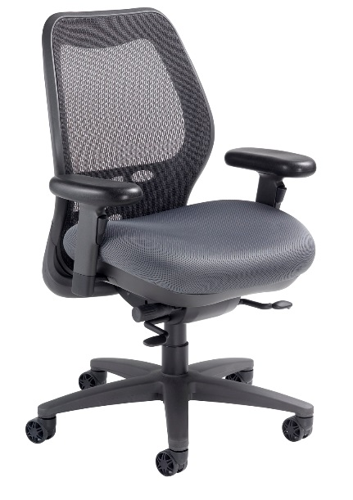
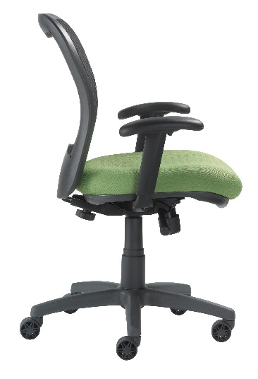
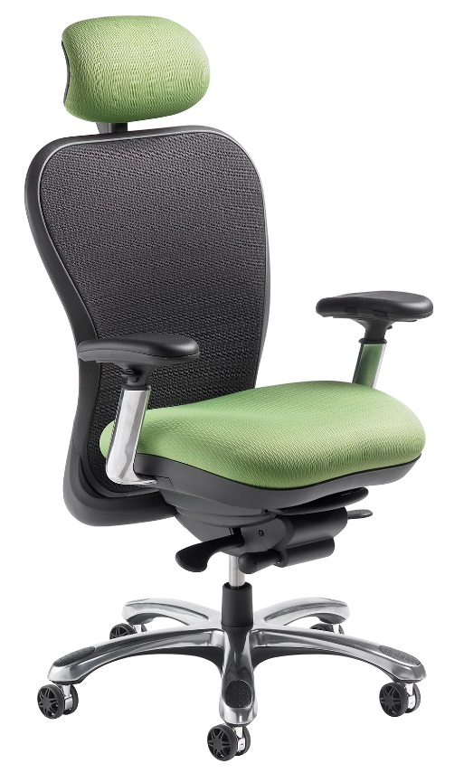
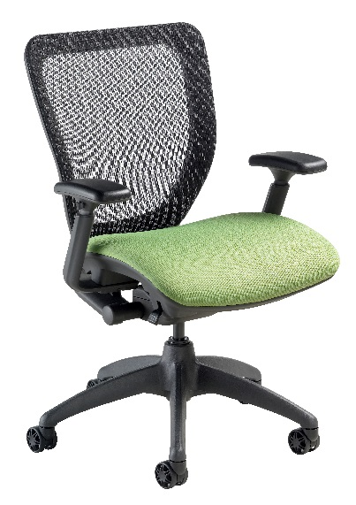
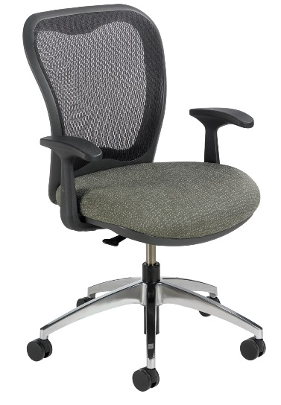
SXO
LXO
WXO
MXO
CXO
ENERSORB™ Standard

Slide 17
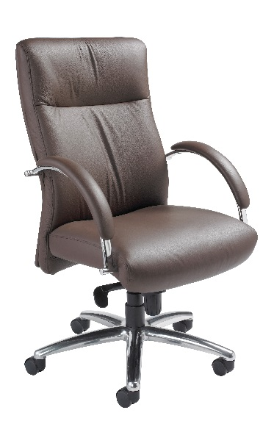
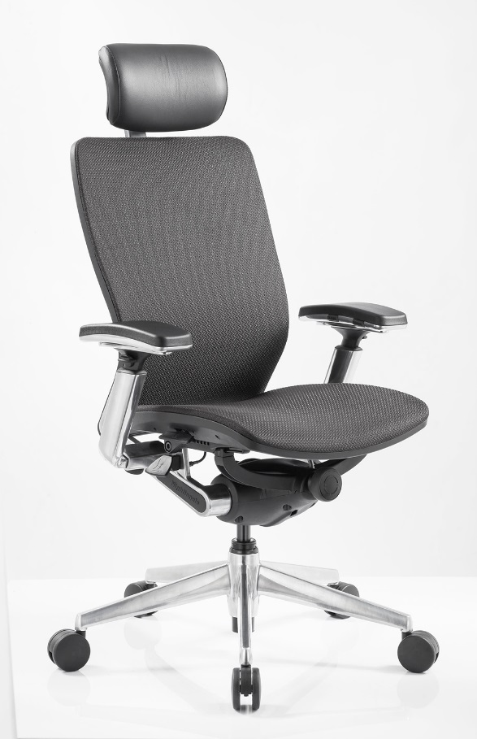
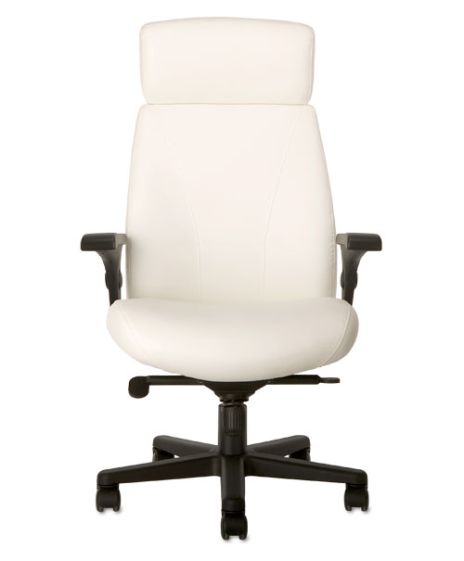
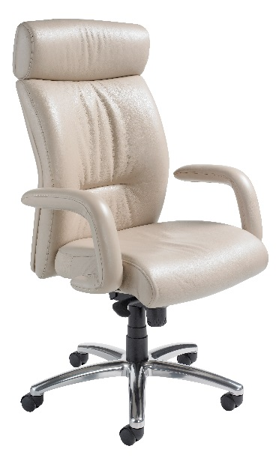
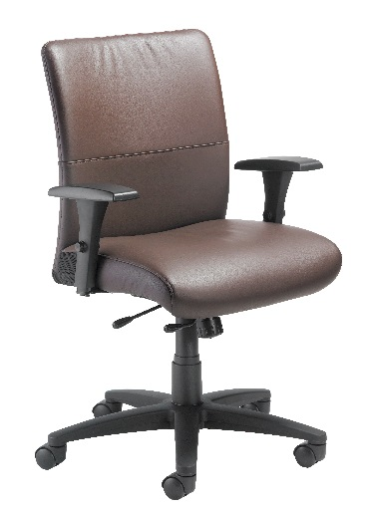
Khroma
Presider
IC2
Manno
Tuxedo
ENERSORB™ Standard

Slide 18
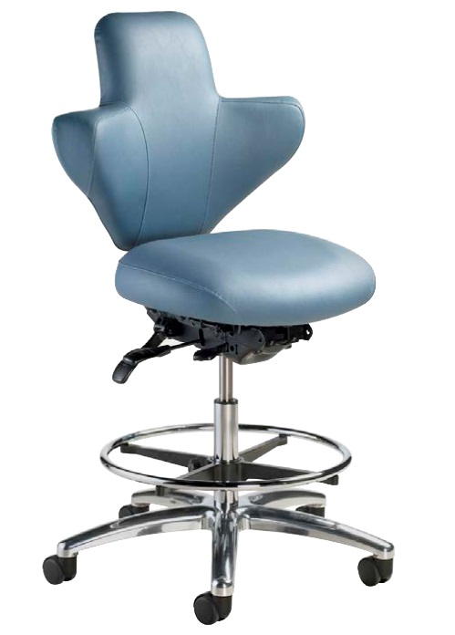
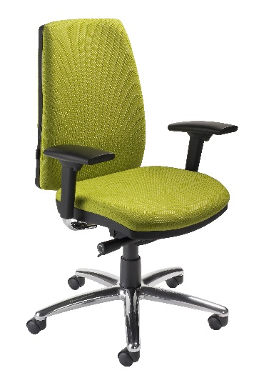
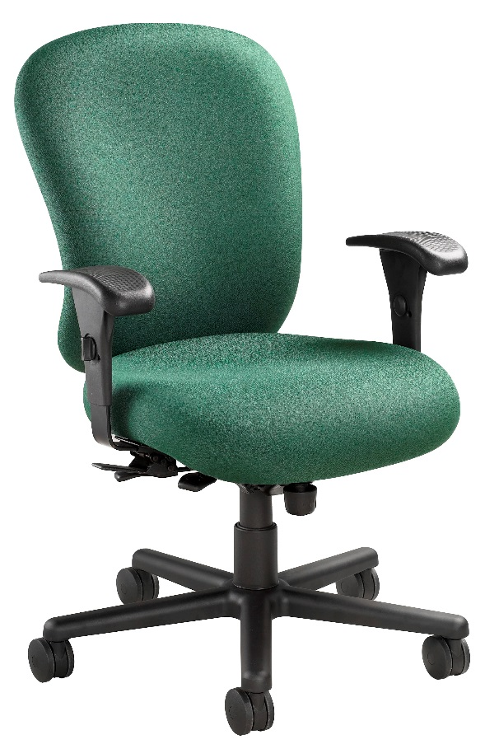
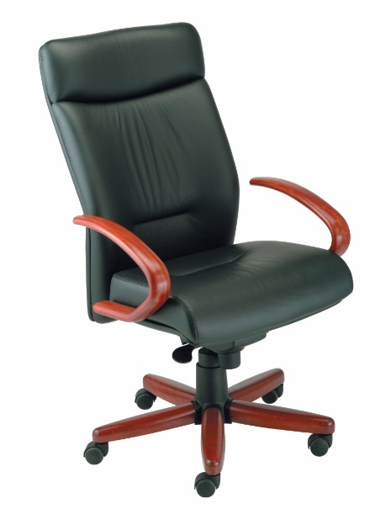
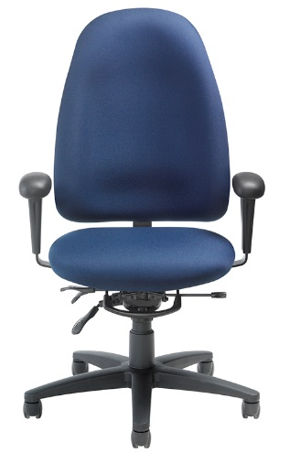
Surgeon
Console
Veronna
24/7 HD
Manno
Timber
Ergo
Learn
ENERSORB™ Standard

Slide 19
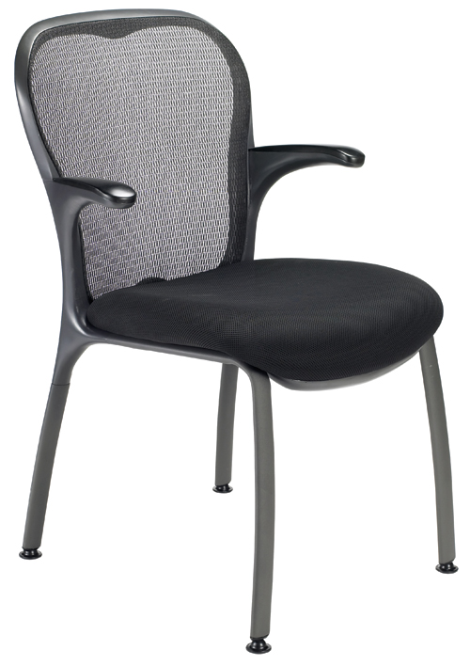
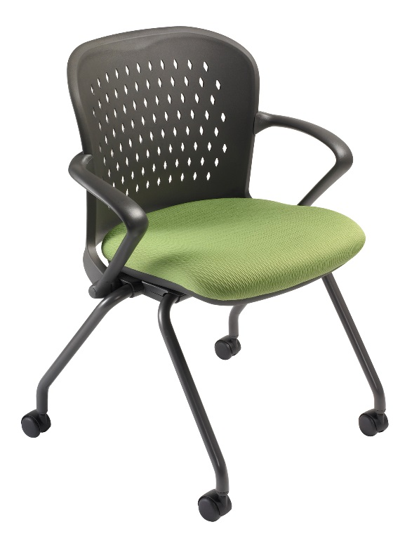
GXO
NXO
ENERSORB™ Standard

Slide 20
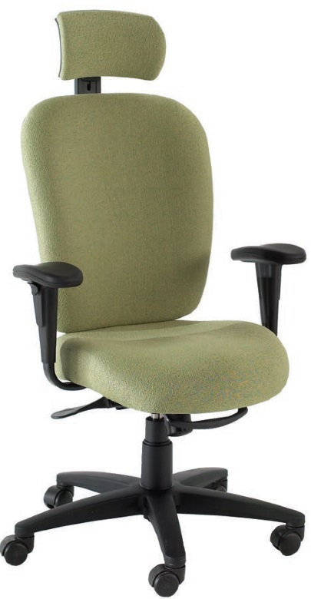
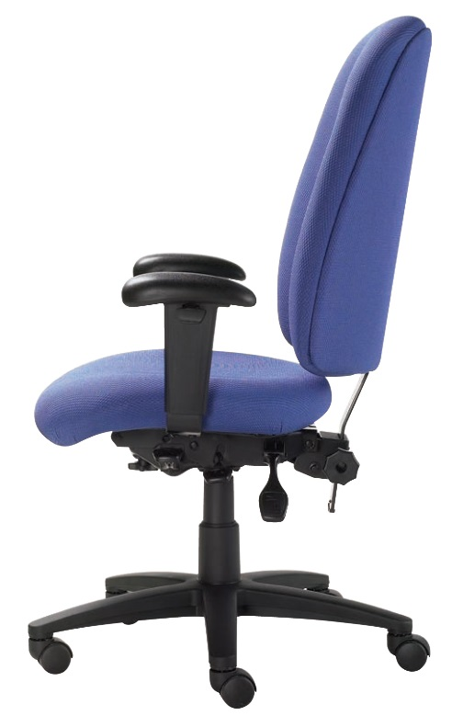
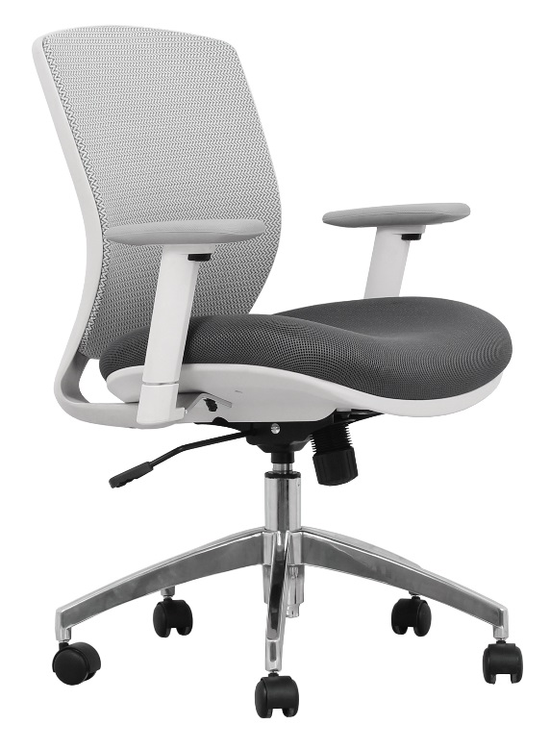
Dany VXO Edge
ENERSORB™ Optional

Slide 21
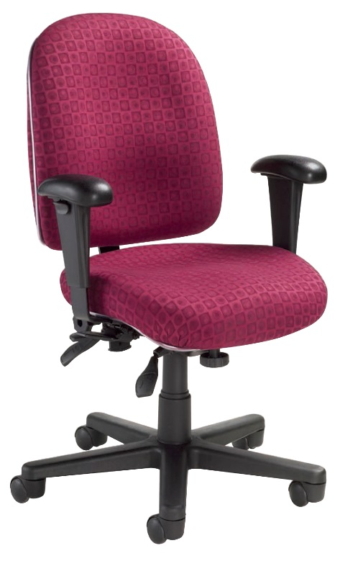
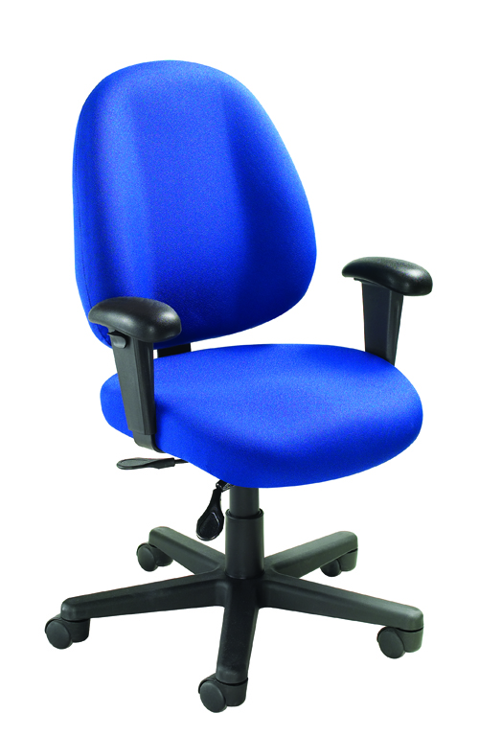
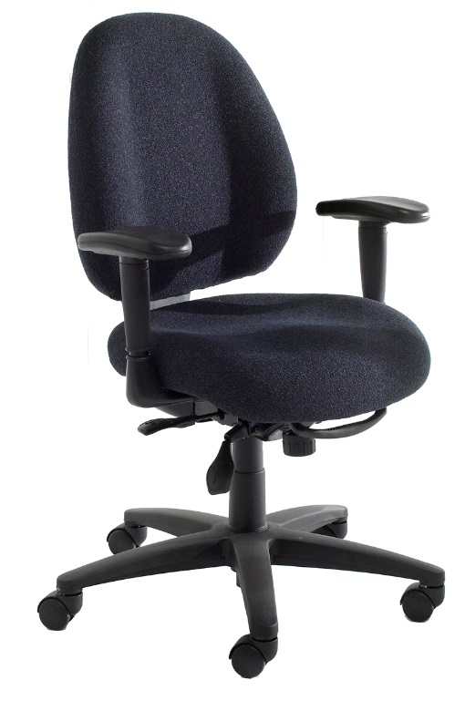
Bear Buddy Legacy
ENERSORB™ Optional

Slide 22
Mark Francis
Learning & Development Manager
Nightingale University
905.896.3434
800.363.8954
Ext 204
mfrancis@nightingalechairs.com
www.nightingalechairs.com

