Slide 1
Drafting Stool Collection
Seating Excellence since 1928
This presentation is confidential and is intended only for the individual named. Disclosing, copying, distributing or taking any action in reliance on the contents of this information is strictly prohibited

Slide 2
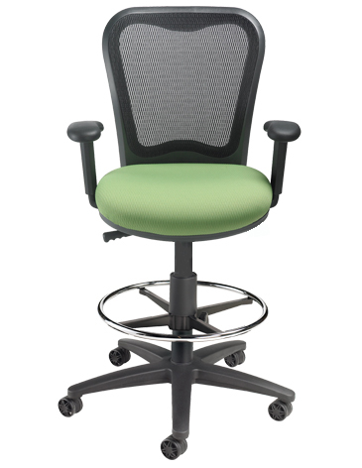
The Height of
Higher Seating Solutions

Slide 3
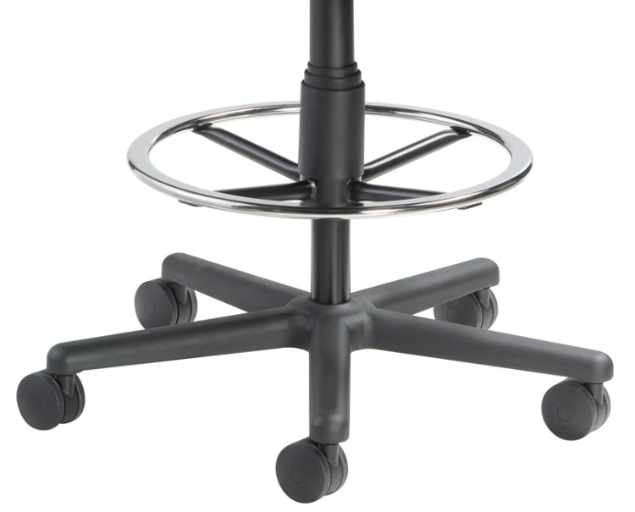
HD Foot-Ring
now standard on
all Drafting Stool chairs
... at no additional charge !

Slide 4
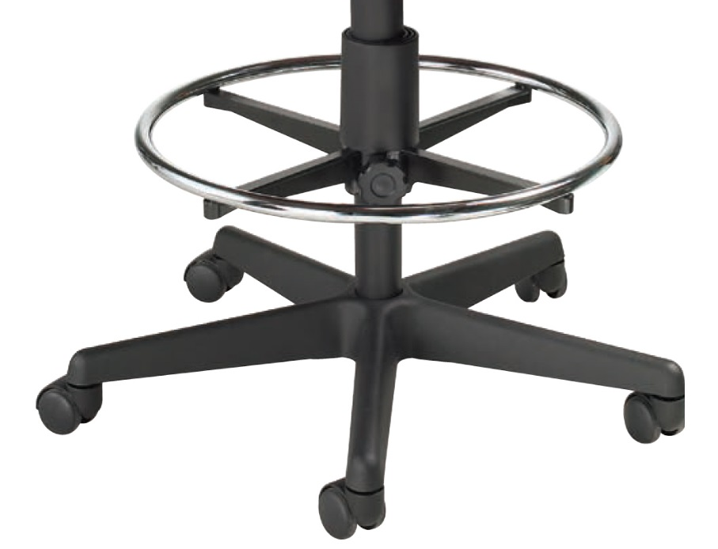
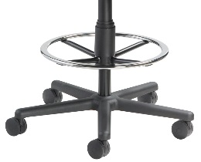
OLD Foot-Ring
Flat ring offers increased support
for feet to rest
Plated, cold rolled steel
NEW Foot-Ring

Slide 5
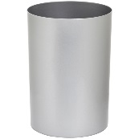
OLD
Locking Pin
NEW
Locking Sleeve
Easily twists to loosen and then reset at required height for
multi-user applications
Twist motion locks ring securely in place at any position along column; with a full sleeve

Slide 6
Swivel Mechanism
Arm height adjustment
Seat depth adjustment
6000DS Arm
6007DS Armless
40.5”-50.5”

Slide 7
Applications
Banking: Tellers
Library
Factory
Multi-users
Matching DS for
LXO standard

Slide 8
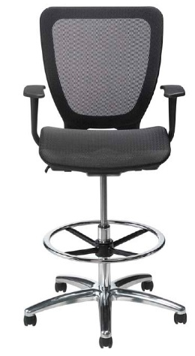
ABLEX™ Memory Mesh
on back and seat
Height adjustable arms
3 way pivoting,
locking arm pads
Contoured waterfall
seat design
5850DS
44”- 54.75”

Slide 9
Applications
Banking: Tellers
Library
Multi-users
Matching DS for
WXO standard
Hi-tech industry:
strong aesthetic

Slide 10
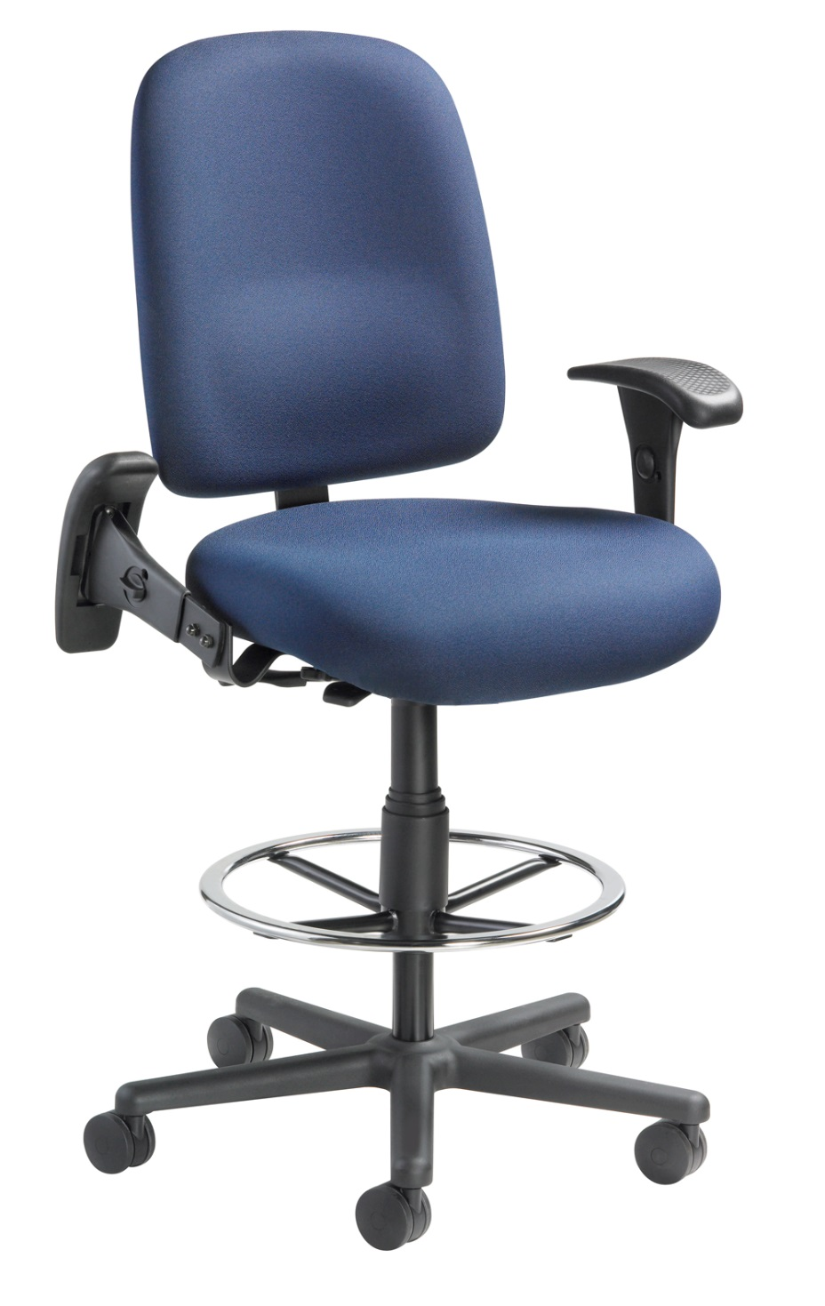
Swivel Mechanism
2.5" seat depth adjustment
Built in lumbar support
Oversized seat pan
with a waterfall edge
Reinforced steel seat
and back bar
HD9000DS
44”-52”

Slide 11
Heavy duty steel fold away arms that are height
and width adjustable
Soft polyurethane
arm pads
Armless
Supports 350 lbs capacity
3 shifts a day: 24/7 usage

Slide 12
Applications
Law Enforcement
911 Call Center
Fire Halls
Security
Laboratory
Factory

Slide 13
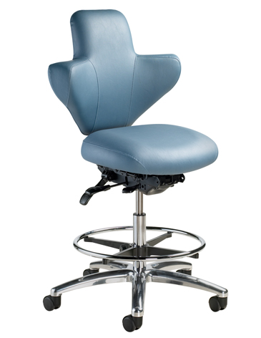
Swivel mechanism
Integrated back and arm
with patented torsion spring
system that adjusts to each individual user for ergonomic lumbar support and comfort
Built-in ratchet system for back height adjustment
Seat slide adjustment
1864DS
40.5”-48”

Slide 14
Applications
Health care
Hospital:
Nursing Station
Clinic
Laboratory
Anywhere sanitation requirements are mandatory

Slide 15
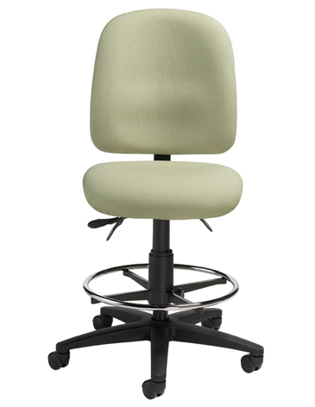
Swivel mechanism
Articulating seat
and back adjustment
3207DS
42.5"-54.5"

Slide 16
Applications
Standards for all
fabric DS
A/D Education institutions: High Schools
Colleges
Chemistry/Biology Lab:
High Schools
Colleges

Slide 17
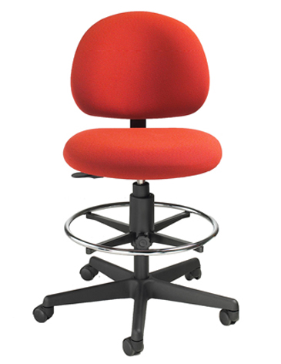
Swivel mechanism
Seat depth
adjustment
3606DS
24"-34"

Slide 18
Applications
Standards for all
fabric DS
A/D Education institutions: High Schools
Colleges
Chemistry/Biology Lab:
High Schools
Colleges

Slide 19
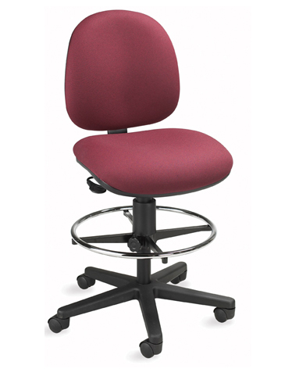
Swivel mechanism
Seat depth
adjustment
6805DS
40"-50"

Slide 20
Applications
Standards for all
fabric DS
A/D Education institutions: High Schools
Colleges
Chemistry/Biology Lab:
High Schools
Colleges

Slide 21
Level 1 e3 Certified
GREENGUARD Children & School and Indoor Air Quality Certified
Nightingale is a 100% waste free facility; powered by Solar & Wind

Slide 22
Rating & Warranty
Rated for users up to 250 pounds, for a 40 hour work week
Lifetime Limited: All non-moving metal parts.
10 Years: Frame & Parts
5 Years: Upholsteries

Slide 23
Questions ?

Slide 24
Mark Francis
Learning & Development Manager
Nightingale University
905.896.3434
800.363.8954
Ext 204
mfrancis@nightingalechairs.com
www.nightingalechairs.com

