Slide 1
Seating Excellence since 1928
This presentation is confidential and is intended only for the individual named. Disclosing, copying, distributing or taking any action in reliance on the contents of this information is strictly prohibited

Slide 2
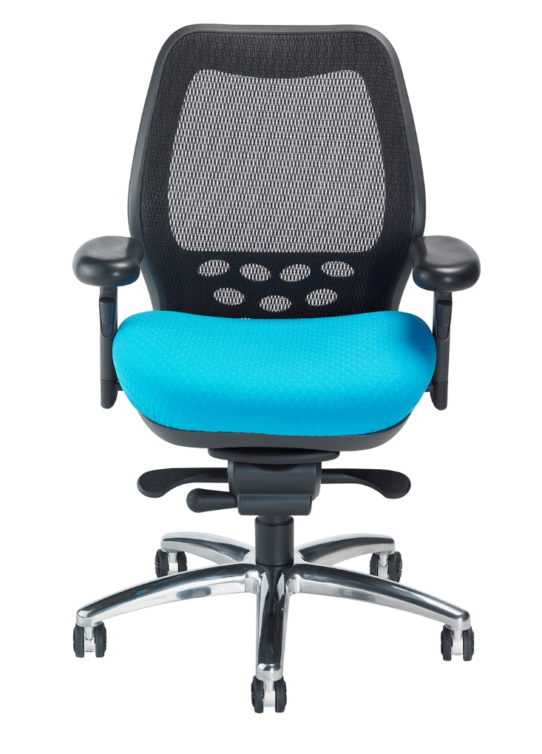
Simplified
Ergonomics
Simplicity of Design
Simplicity of Function
Get comfortable with
your decision to
get comfortable

Slide 3
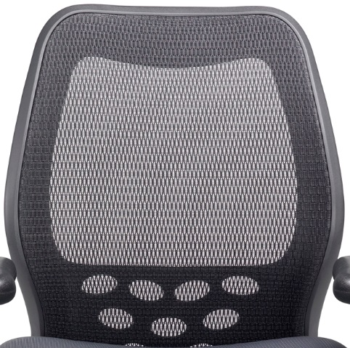
Back
Translucent ABLEX patterned weave mesh back provides generous lumbar support while allowing dynamic back movement.
Allows air to pass freely,
making it comfortable
in all climes

Slide 4
Contoured seat and back shell for ergonomic support
Pronounced curve is designed to sync with mesh in offering superior lumbar support

Slide 5
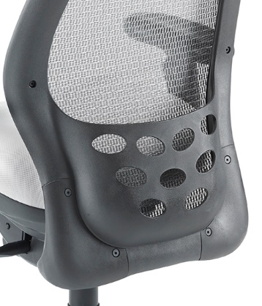
Patented all purpose back storage pocket built into
the back frame allows convenient storage for
company mail or
personal items

Slide 6
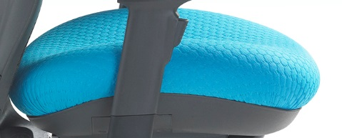
Seat
Contoured seat incorporates a “waterfall”
design that gently slopes away from the legs,
minimizing pressure
on the thighs,
promoting
good posture
Energy absorbing ENERSORB™ seat foam reduces sitting fatigue by minimizing pressure points and increasing blood circulation

Slide 7
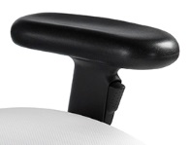
Arm
Armrest Movement
Up / Down
In / Out
Lockable Swivel Pads

Slide 8
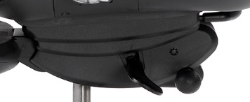
Mech
Synchronous knee-tilt swivel mechanism with built-in seat slide
depth adjuster
Infinite
position tilt-lock
Pneumatic seat
height adjustment
Side tension control

Slide 9
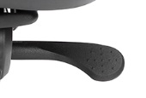
Intuitive easy grip side tension adjustment
Infinite
position tilt-lock

Slide 10
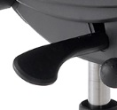
Pneumatic seat
height adjustment
Built-in seat slide
depth adjuster

Slide 11
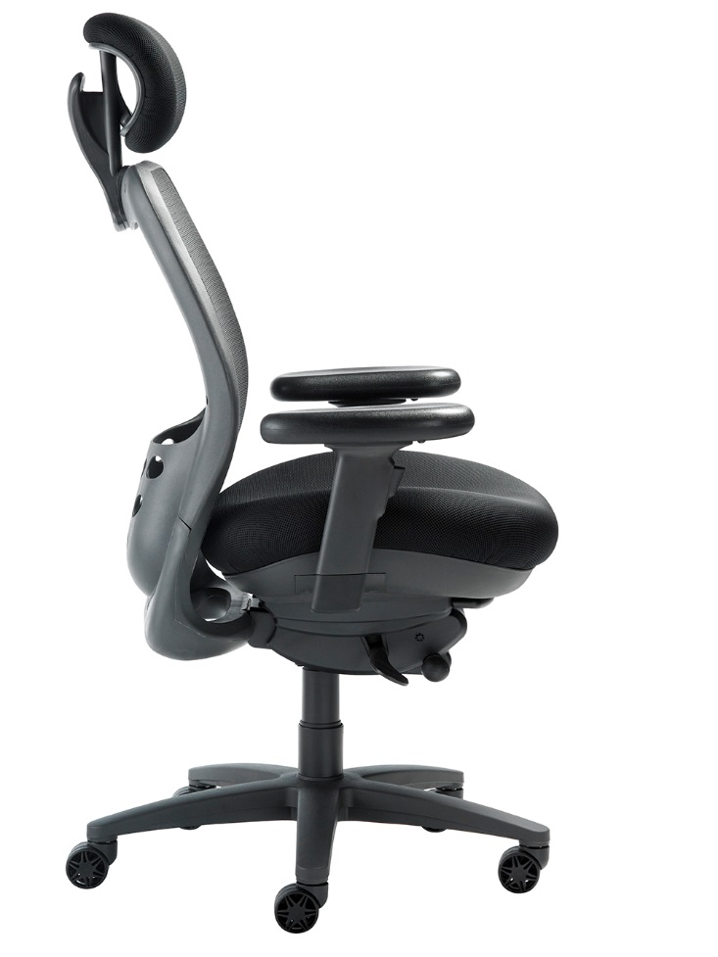
Finish
Mechanism, base,
arms, casters and
trim standard
in graphite

Slide 12
Applications
Mid-Back
Boardroom
Task
Headrest
Executive
Taller Users
Ergonomic Assessment
for Back Issues

Slide 13
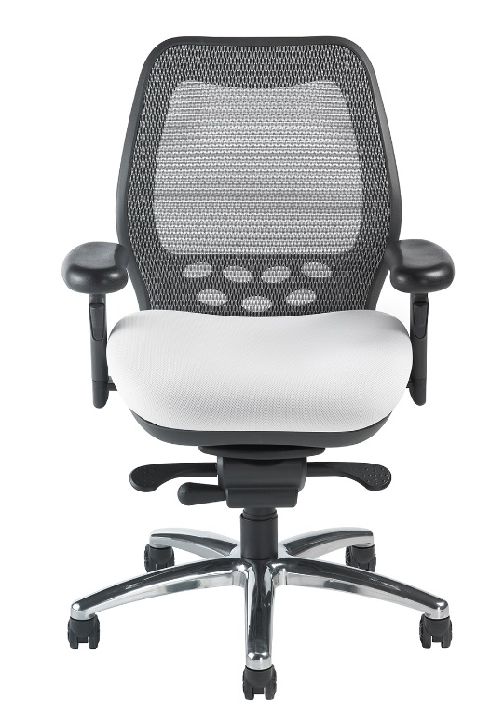
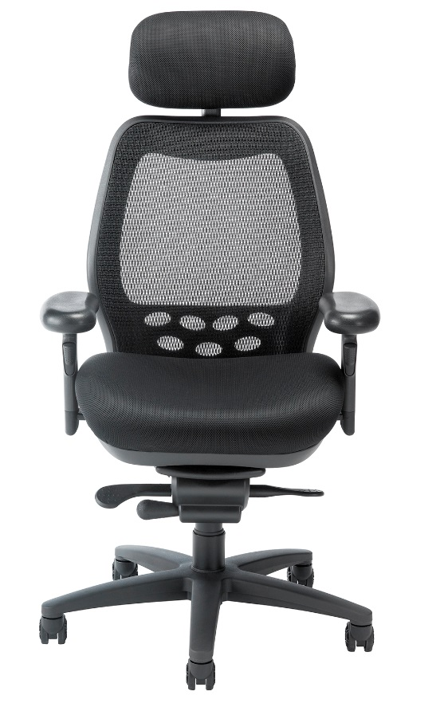
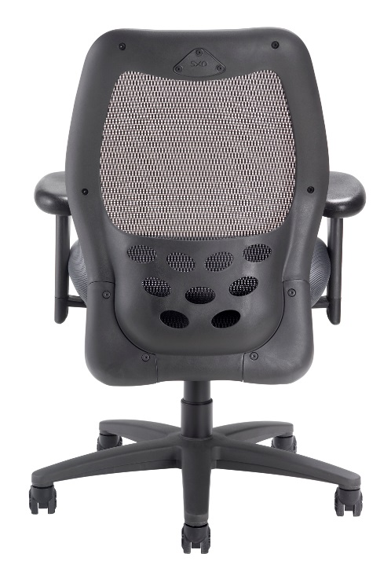
Options
Soft Tile Casters 2”
3" Carpet Casters
Polished Aluminum Base
Silver Mesh
California Fire Code #133

Slide 14
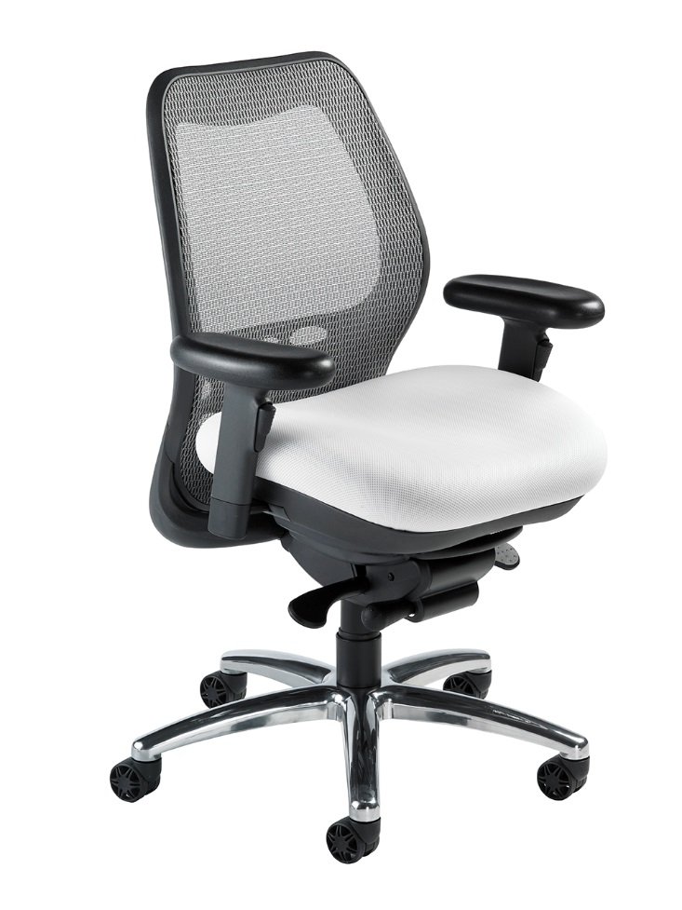
Level 1 e3 Certified
GREENGUARD Children & School and Indoor Air Quality Certified
Nightingale is a 100% waste
free facility; powered by
Solar & Wind

Slide 15
Rating & Warranty
Rated for users up to 350 pounds, for a 40 hour work week
Lifetime Limited: All non-moving metal parts.
10 Years: Frame & Parts
5 Years: Upholsteries

Slide 16
Any Questions ?

Slide 17
Mark Francis
Learning & Development Manager
Nightingale University
905.896.3434
800.363.8954
Ext 204
mfrancis@nightingalechairs.com
www.nightingalechairs.com

